Slide 1
Chapter 11: File-System Interface
File Concept
Access Methods
Directory Structure
File System Mounting
File Sharing
Protection
Operating System Concepts

Slide 2
File Concept
Computers can store information on various storage media, such as magnetic
disks, magnetic tapes, and optical disks.
So that the computer system will be convenient to use, the operating system provides a uniform logical view of stored information.
The operating system abstracts from the physical properties of its storage devices to define a logical storage unit, the file.
Files are mapped by the operating system onto physical devices.
These storage devices are usually nonvolatile, so the contents are persistent between system reboots.
Operating System Concepts

Slide 3
File Concept
A file is a named collection of related information that is recorded on secondary storage.
From a user’s perspective, a file is the smallest allotment of logical secondary storage; that is, data cannot be written to secondary storage unless they are within a file.
Representation of files as:
  Data
    numeric
    character
    binary
  Program
Operating System Concepts

Slide 4
File Structure
None - sequence of words, bytes
Simple record structure
  Lines
  Fixed length
  Variable length
Complex Structures
  Formatted document
  Relocatable load file
Can simulate last two with first method by inserting appropriate control characters.
Who decides:
  Operating system
  Program
Operating System Concepts

Slide 5
File Attributes
Name – only information kept in human-readable form.
Type – needed for systems that support different types.
Location – pointer to file location on device.
Size – current file size.
Protection – controls who can do reading, writing, executing.
Time, date, and user identification – data for protection, security, and usage monitoring.
Information about files are kept in the directory structure, which is maintained on the disk.
Operating System Concepts

Slide 6
Directory Structure
The information about all files is kept in the directory structure, which also resides on secondary storage.
Typically, a directory entry consists of the file’s name and its unique identifier.
The identifier in turn locates the other file attributes.
It may take more than a kilobyte to record this information for each file.
In a system with many files, the size of the directory itself may be megabytes.
Because directories, like files, must be nonvolatile, they must be stored on the device and brought into memory piecemeal, as needed.
Operating System Concepts

Slide 7
File Operations
Create
Write
Read
Reposition within file – file seek
Delete
Truncate
Open(F_{i}) – search the directory structure on disk for entry F_{i}, and move the content of entry to memory.
Close (F_{i}) – move the content of entry F_{i} in memory to directory structure on disk.
Operating System Concepts

Slide 8
Data Structures related to files
The operating system keeps a table, called the system-wide open-file table, containing information about all open files.
When a file operation is requested, the file is specified via an index into this table, so no searching is required.
When the file is no longer being actively used, it is closed by the process, and the operating system removes its entry from the open-file table.
Operating System Concepts

Slide 9
Data Structures related to files
The per process file table tracks all files that a process has open.
Stored in this table is information regarding the process’s use of the file.
For instance, the current file pointer for each file is found here.
Access rights to the file and accounting information can also be included.
Operating System Concepts

Slide 10
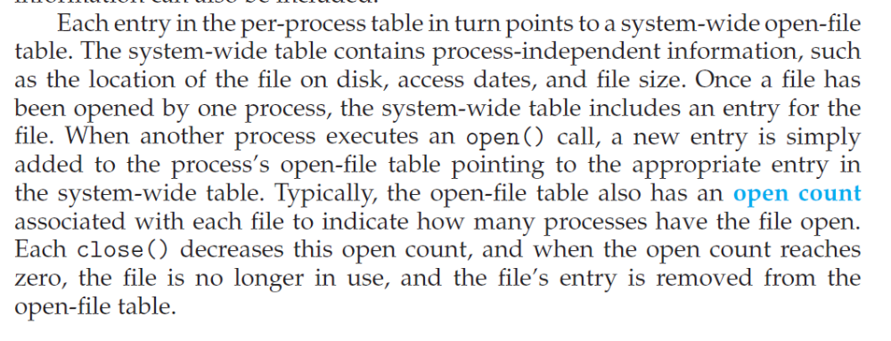
Data Structures related to files
Operating System Concepts

Slide 11
Data Structures related to files
Information to be stored for a open file
  File pointer
  Access rights
  Disk location of the file
  File open count
Operating System Concepts

Slide 12

File Types – Name, Extension
Operating System Concepts

Slide 13
Access Methods
Files store information.
When it is used, this information must be accessed and read into computer memory.
The information in the file can be accessed in several ways.
Operating System Concepts

Slide 14
Sequential Access
The simplest access method is sequential access. Information in the file is processed in order, one record after the other.
This mode of access is by far the most common; for example, editors and compilers usually access files in this fashion.
Operating System Concepts

Slide 15

Sequential-access File
Operating System Concepts

Slide 16
Direct Access
Another method is direct access (or relative access). Here, a file is made up of fixed-length logical records that allow programs to read and write records rapidly in no particular order.
The direct-access method is based on a disk model of a file, since disks allow random access to any file block.
Operating System Concepts

Slide 17

Simulation of Sequential Access on a Direct-access File
Operating System Concepts

Slide 18
Other Access Methods
Other access methods can be built on top of a direct-access method.
These methods generally involve the construction of an index for the file.
The index, like an index in the back of a book, contains pointers to the various blocks.
To find a record in the file, we first search the index and then use the pointer to access the file directly and to find the desired record.
Operating System Concepts

Slide 19

Example of Index and Relative Files
Operating System Concepts

Slide 20
Directory Structure
Files are stored on random-access storage devices, including hard disks, optical disks, and solid-state (memory-based) disks.
A storage device can be used in its entirety for a file system.
It can also be subdivided for finer-grained control. For example, a disk can be partitioned into quarters, and each quarter can hold a separate file system.
Any entity containing a file system is generally known as a volume.
Each volume that contains a file system must also contain information about the files in the system.
This information is kept in entries in a device directory or volume table of contents.
The device directory (more commonly known simply as the directory) records information
Operating System Concepts

Slide 21
Directory Structure
A collection of nodes containing information about all files.
Directory
Files
F 1
F 2
F 3
F 4
F n
Both the directory structure and the files reside on disk.
Backups of these two structures are kept on tapes.
Operating System Concepts

Slide 22

A Typical File-system Organization
Operating System Concepts

Slide 23
Information in a Device Directory (Inode Block)
Name
Type
Address
Current length
Maximum length
Date last accessed (for archival)
Date last updated (for dump)
Owner ID (who pays)
Protection information (discuss later)
Operating System Concepts

Slide 24
Operations Performed on Directory
The directory can be viewed as a symbol table that translates file names into their directory entries.
If we take such a view, we see that the directory itself can be organized in many ways.
The organization must allow us to insert entries, to delete entries, to search for a named entry, and to list all the entries in the directory as the operations shown below:
  Search for a file
  Create a file
  Delete a file
  List a directory
  Rename a file
  Traverse the file system
Operating System Concepts

Slide 25
Organize the Directory (Logically) to Obtain
Efficiency – locating a file quickly.
Naming – convenient to users.
  Two users can have same name for different files.
  The same file can have several different names.
Grouping – logical grouping of files by properties, (e.g., all Java programs, all games, …)
Operating System Concepts

Slide 26

Single-Level Directory
A single directory for all users.
Naming problem
Grouping problem
Operating System Concepts

Slide 27

Two-Level Directory
Separate directory for each user. User1/cat/f1.c
Path name
Can have the same file name for different user
Efficient searching
No grouping capability
Operating System Concepts

Slide 28

Tree-Structured Directories
Operating System Concepts

Slide 29
Tree-Structured Directories (Cont.)
Efficient searching
Grouping Capability
Used in many OS (like Linux)
Current directory (working directory)
  cd /spell/mail/prog
  type list
Operating System Concepts

Slide 30
Tree-Structured Directories (Cont.)
Absolute or relative path name
Creating a new file is done in current directory.
Delete a file
rm <file-name>
Creating a new subdirectory is done in current directory.
  mkdir <dir-name>
Example: if in current directory /mail
mkdir count
mail
prog
copy
prt
exp
count
Deleting “mail” ⇒ deleting the entire subtree rooted by “mail”.
Operating System Concepts

Slide 31

Acyclic-Graph Directories
Have shared subdirectories and files.
Operating System Concepts

Slide 32
Acyclic-Graph Directories (Cont.)
Two different names (aliasing) - links
If dict deletes list ⇒ dangling pointer.
Solutions:
  Backpointers, so we can delete all pointers.
  Variable size records a problem.
  Backpointers using a daisy chain organization.
  Entry-hold-count solution.
Operating System Concepts

Slide 33

General Graph Directory
Operating System Concepts

Slide 34
General Graph Directory (Cont.)
How do we guarantee no cycles?
  Allow only links to file not subdirectories.
  Garbage collection.
  Every time a new link is added use a cycle detection
  algorithm to determine whether it is OK.
Operating System Concepts

Slide 35
File System Mounting
A file system must be mounted before it can be accessed - attaching portion of the file system into a directory structure.
A unmounted file system (I.e. Fig. 11-11(b)) is mounted at a mount point.
Operating System Concepts

Slide 36
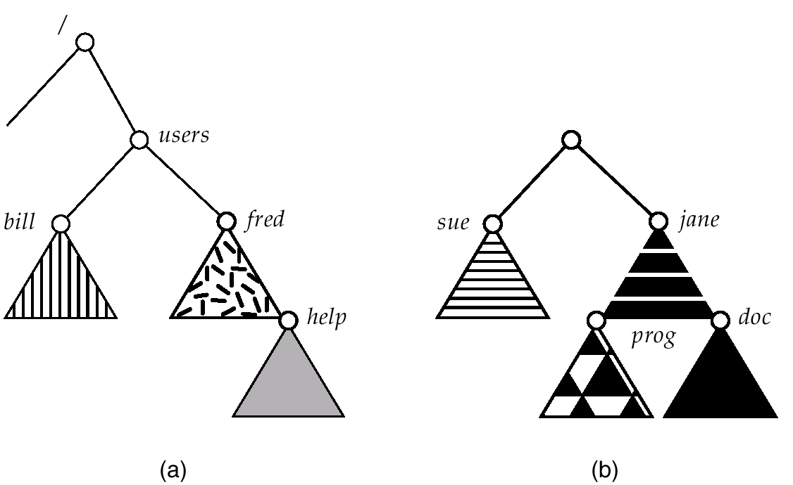
(a) Existing. (b) Unmounted Partition
Operating System Concepts

Slide 37
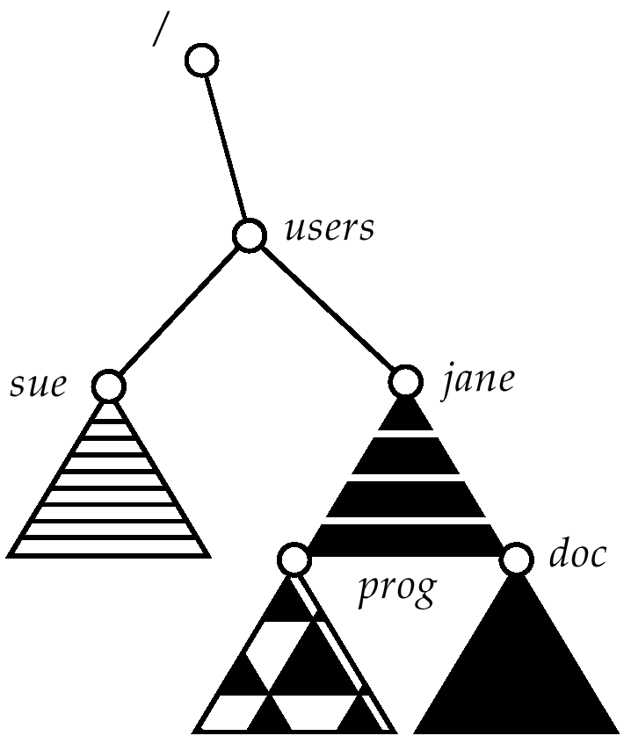
Mount Point
Operating System Concepts

Slide 38
File Sharing
Sharing of files on multi-user systems is desirable.
Sharing may be done through a protection scheme.
On distributed systems, files may be shared across a network.
Network File System (NFS) is a common distributed file-sharing method.
NTFS – New Technology File System
Operating System Concepts

Slide 39
Protection
File owner/creator should be able to control:
  what can be done
  by whom
Types of access
  Read
  Write
  Execute
  Append
  Delete
  List
Operating System Concepts

Slide 40
Access Control Lists(ACL) and Groups
Mode of access: read, write, execute
Three classes of users
RWX
a) owner access 7 ⇒ 4 2 1
RWX
b) group access 6 ⇒ 4 2 0
RWX
c) public access 1 ⇒ 0 0 1
Ask manager to create a group (unique name), say G, and add some users to the group.
For a particular file (say game) or subdirectory, define an appropriate access.
owner
group
public
chmod
761
game
Attach a group to a file
chgrp G game
Operating System Concepts

